Slide 1
Adaptation Concepts
Anastasia Lykhtar, Dmitriy Monakhov

Slide 2
Key functions
Light control
Reading Appliance state
Remote control of appliance
Automation scenarios
Authorization. Separation of roles
Reading sensor data

Slide 3
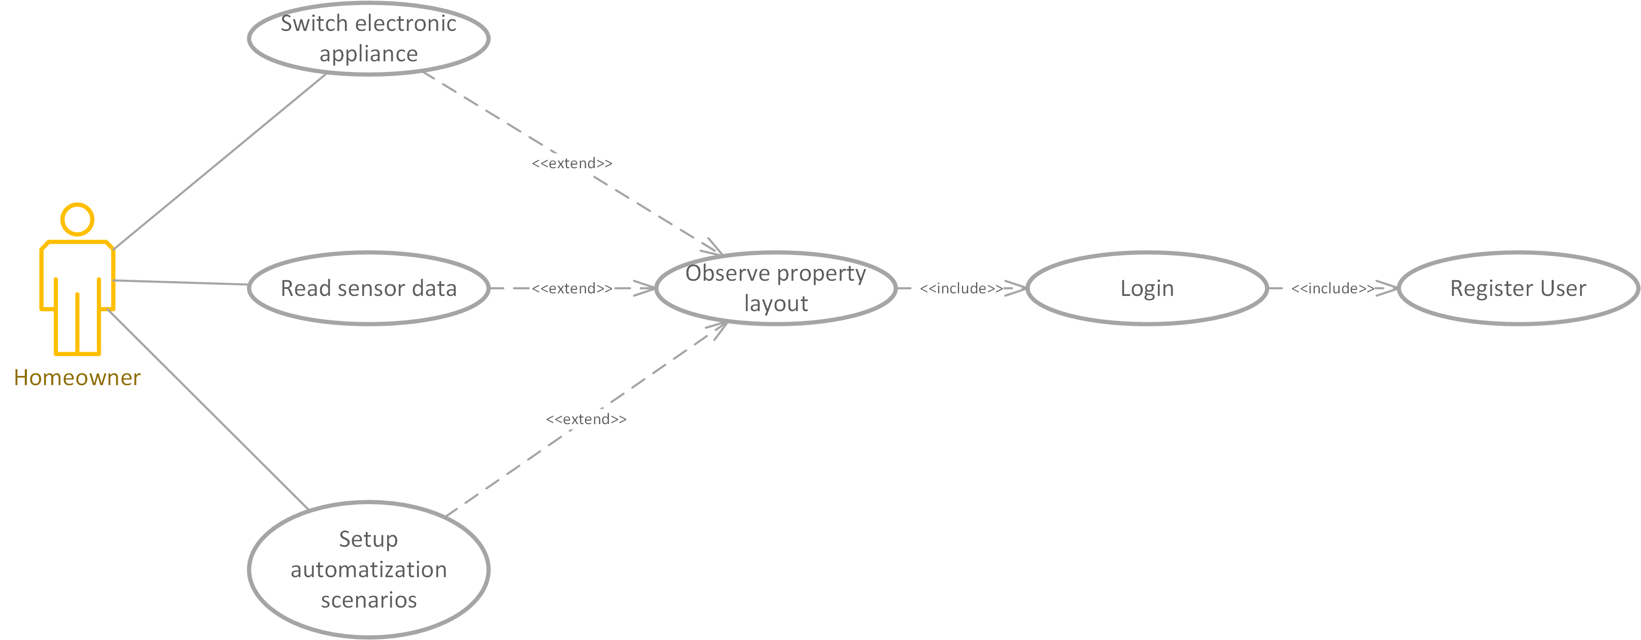
Use Cases

Slide 4
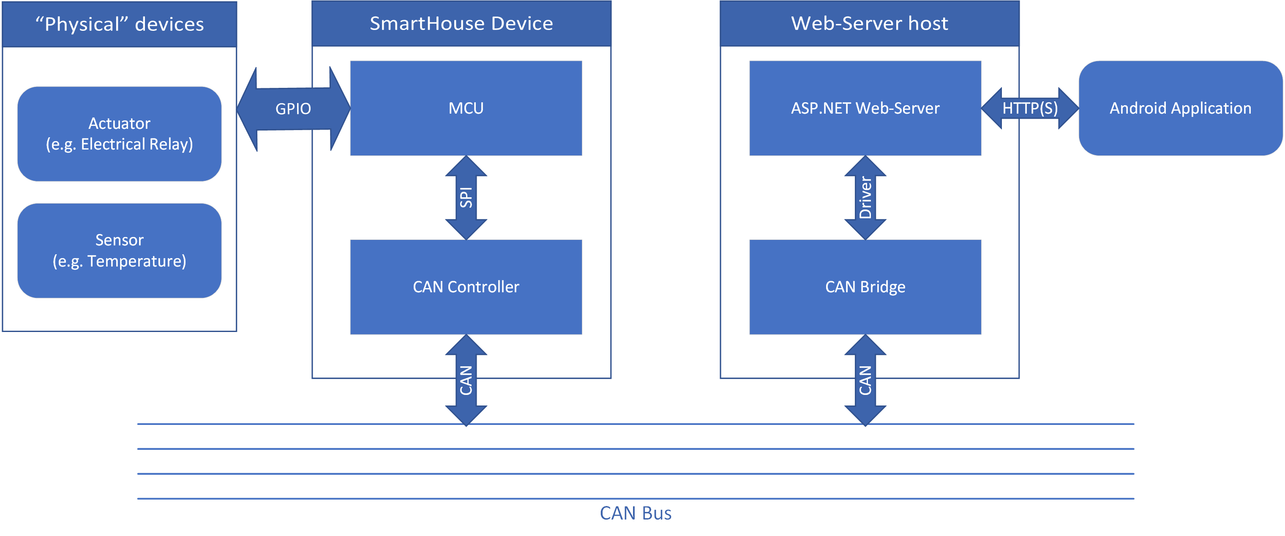
Hardware Structure diagram

Slide 5
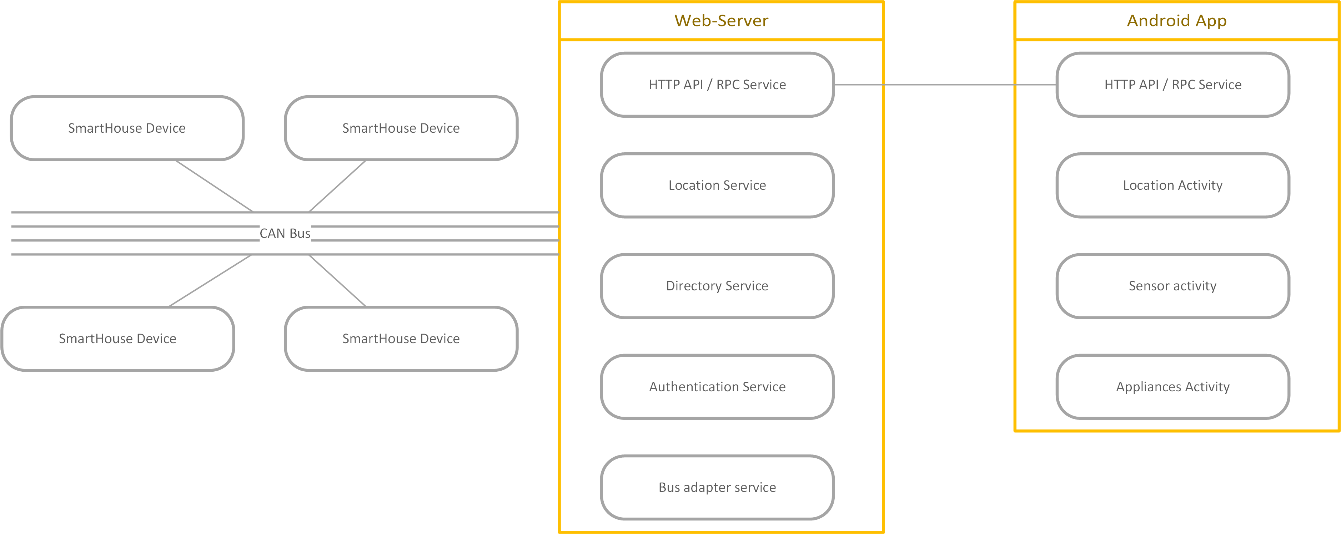
Software Component Structure diagram

Slide 6
Adaptation – Wi-Fi location tracking
Get network state
Check if Wi-Fi SSID is in location tracking Data Base
Measure signal strength and determine the current room
Adaptation: select active room and update screen info depending on location

Slide 7
Adaptation – energy saving
Get battery state
If battery has low charge, then disable server polling for SmartHouse states
User can still update SmartHouse states manually and push updates manually

Slide 8
Problem – user leaves the apartment
We can detect that user is not at home via checking Wi-Fi state
If it is the case, we should switch to WAN connection mode or to offline mode
If we are using WAN mode, the app cannot use adaptation mechanism of location monitoring, but still provided the main features of SmartHouse
If we are using offline mode, the app can only show last known states of SmartHouse equipment and queue user commands for future pushing to the server
When user enters the apartment again, we switch to LAN mode

Slide 9
Problem – battery low
By default, the mobile app periodically polls the server for updates
This requires a permanent connection, which uses lots of battery energy
If the battery is low, we should switch polling off and make the user update state information manually
We also can use Push-notifications, but this technology depends on Google services and thus is unavailable on some devices

Slide 10
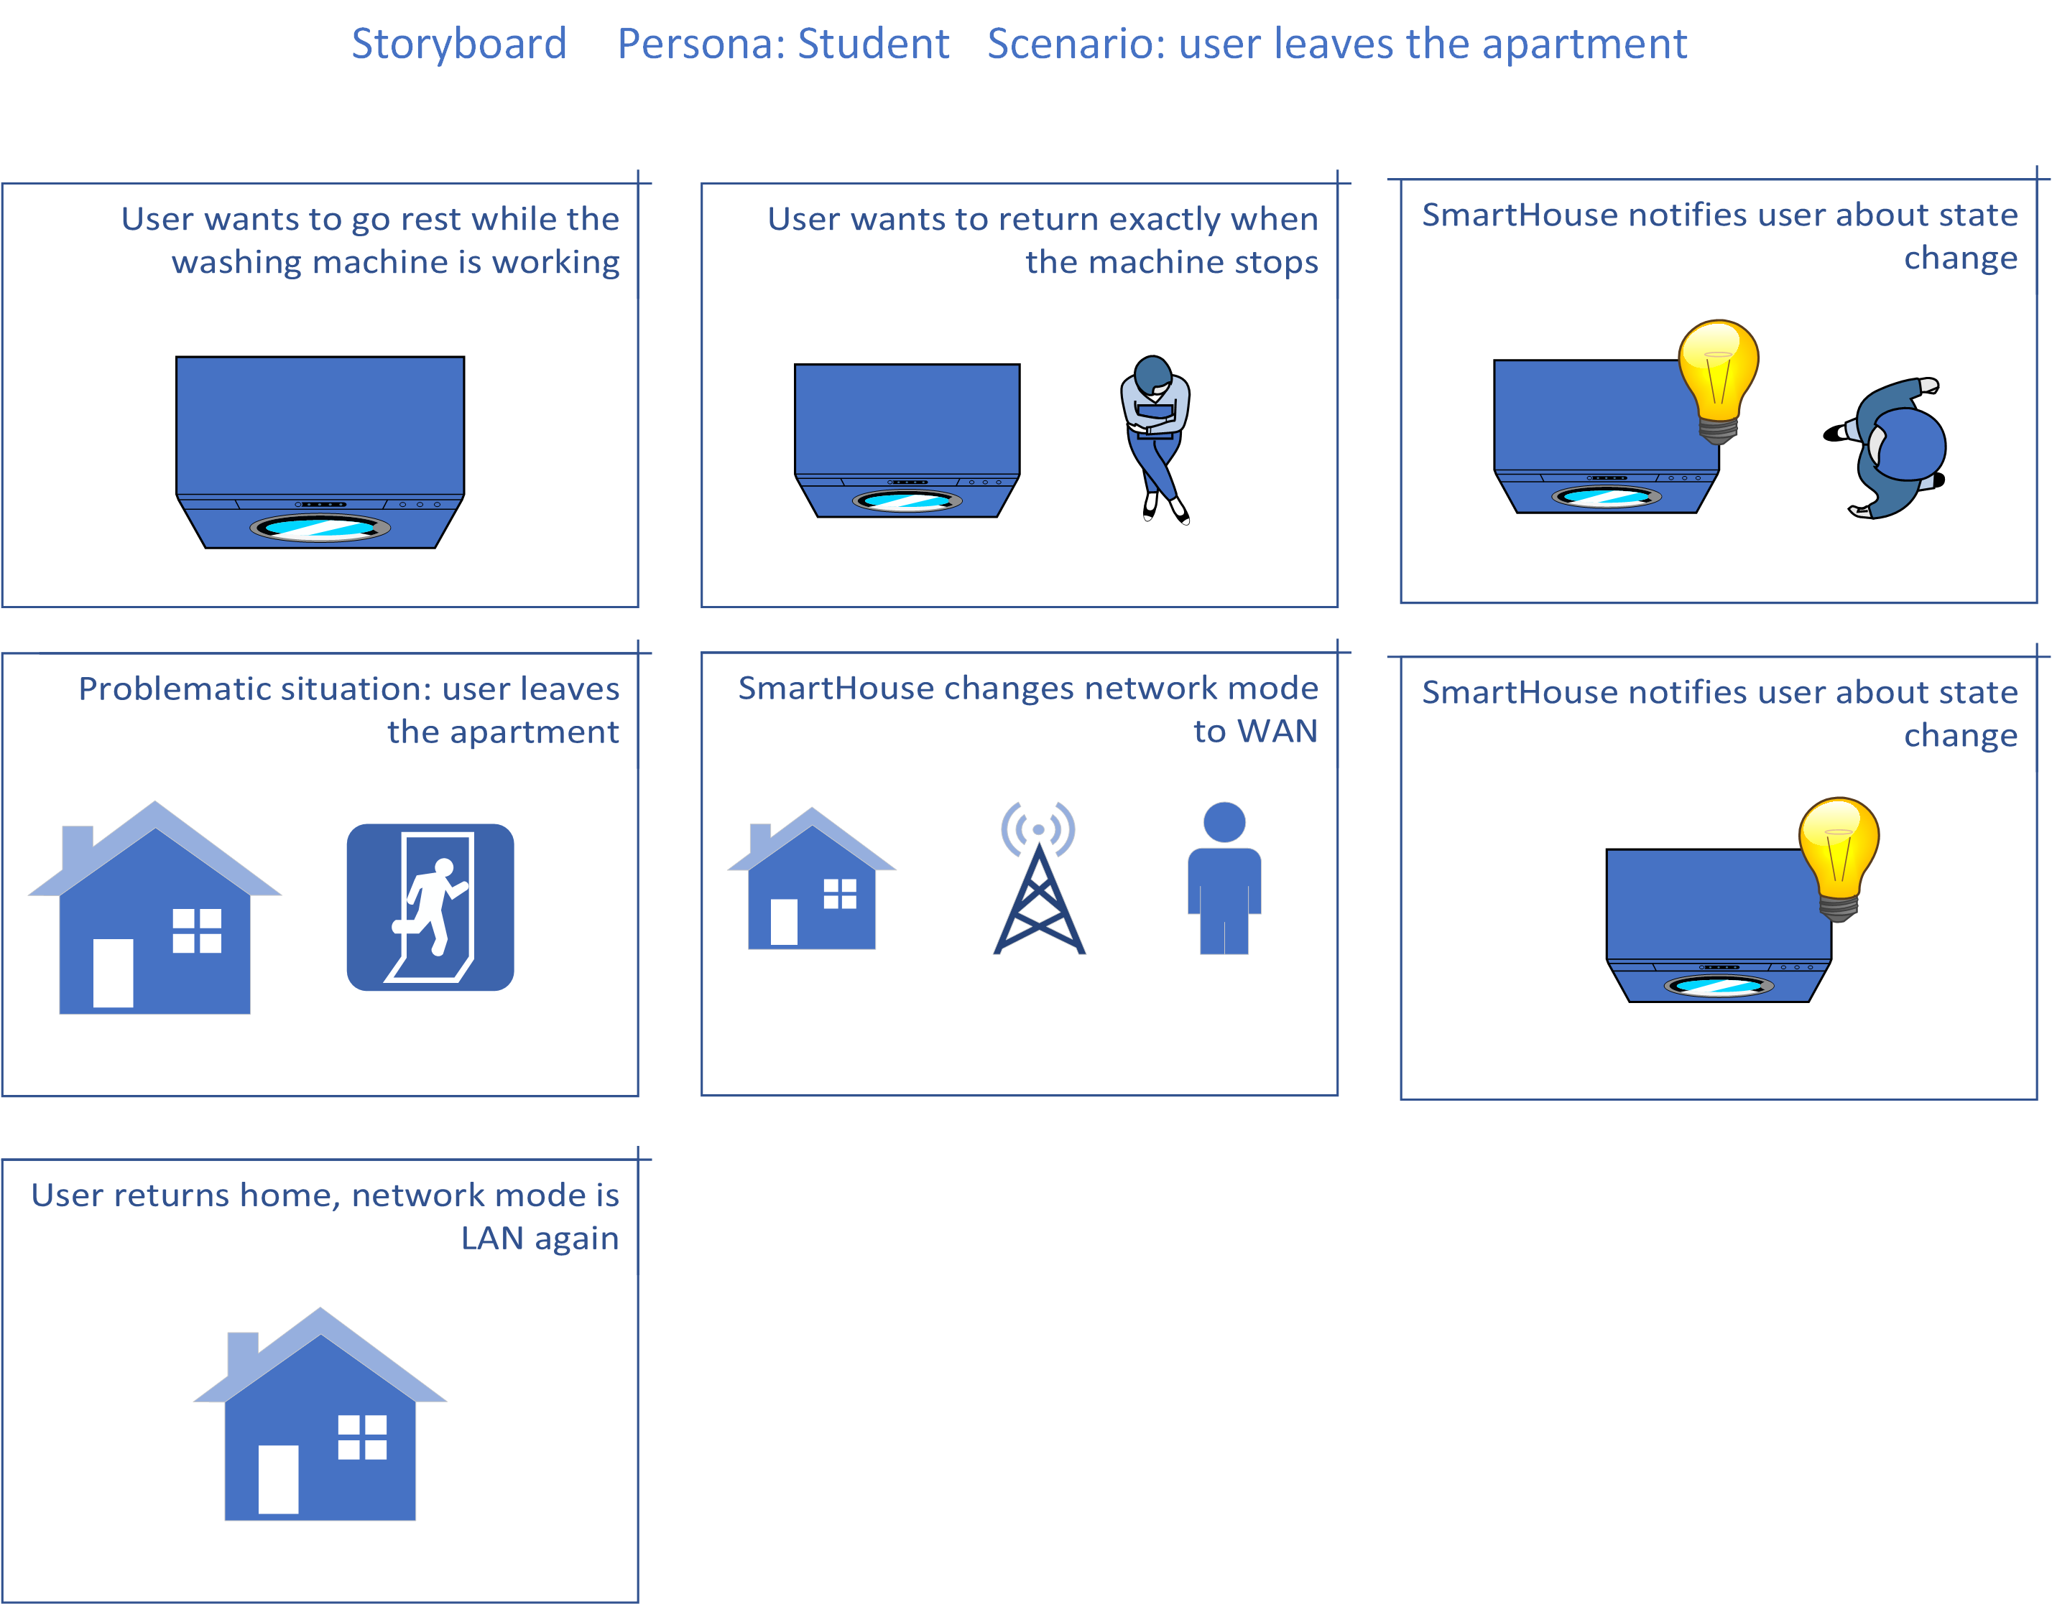
UX Storyline: User leaves the apartment

Slide 11
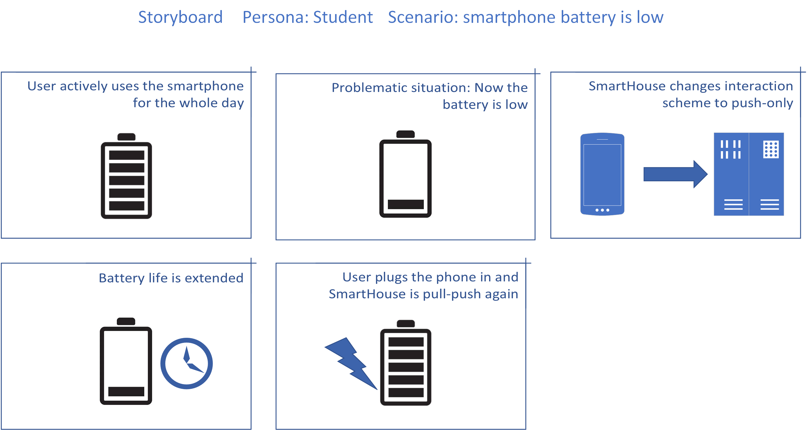
UX Storyline: Battery low

Slide 12
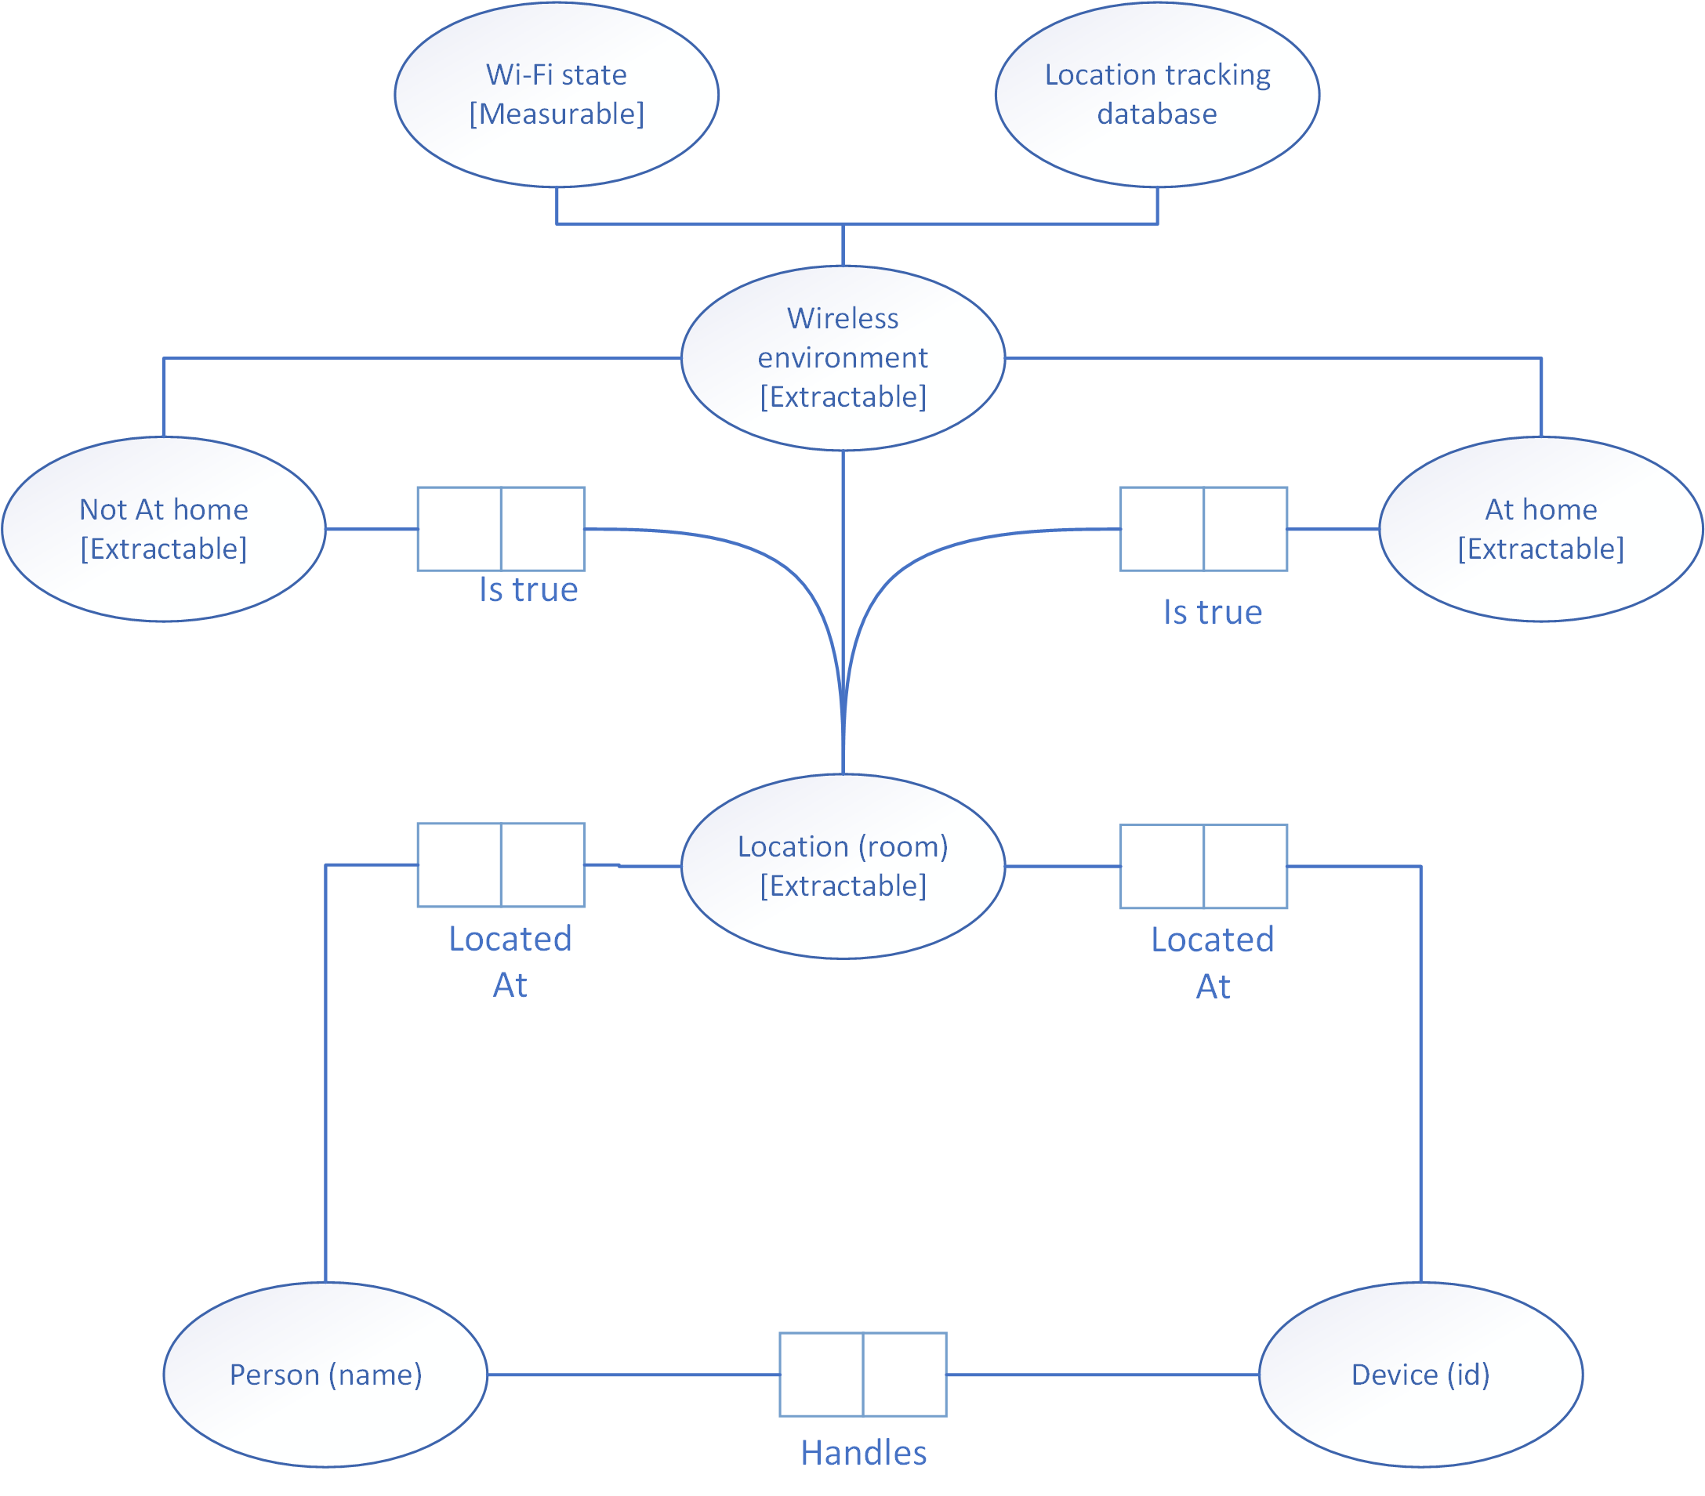
Context Model: Wi-Fi position tracking

Slide 13
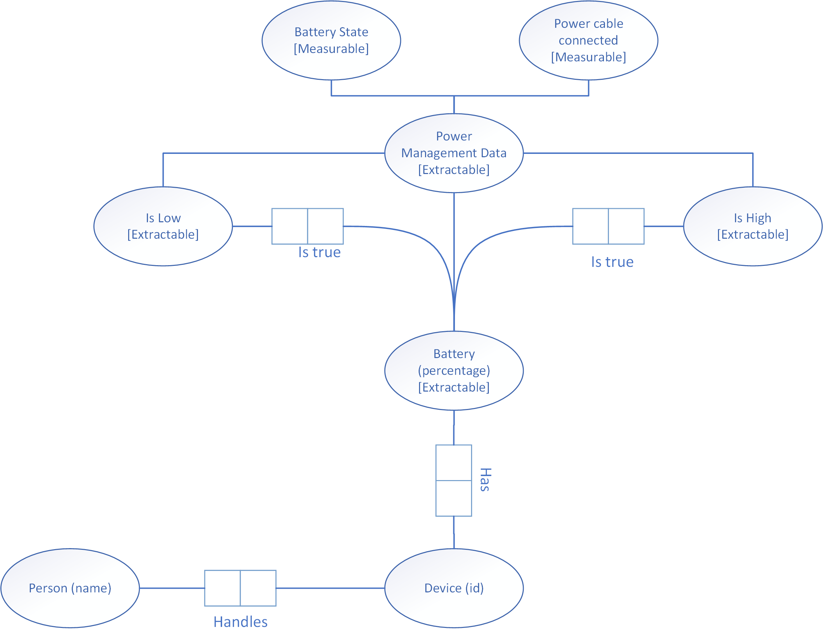
Context Model: Energy saving

Slide 14
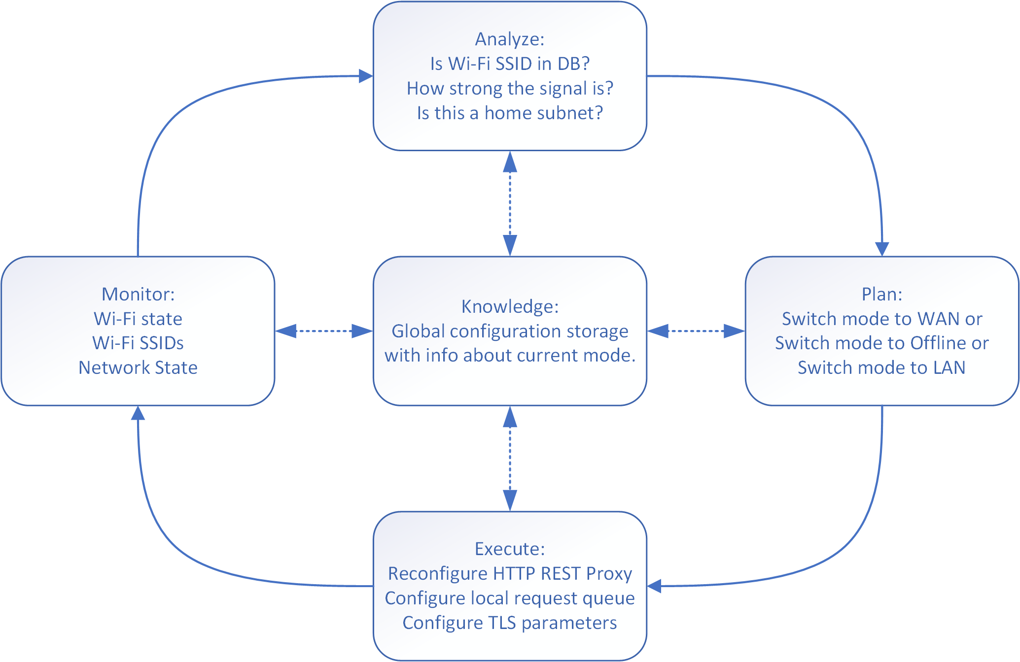
MAPE-K for Connectivity and Offline Challenge

Slide 15
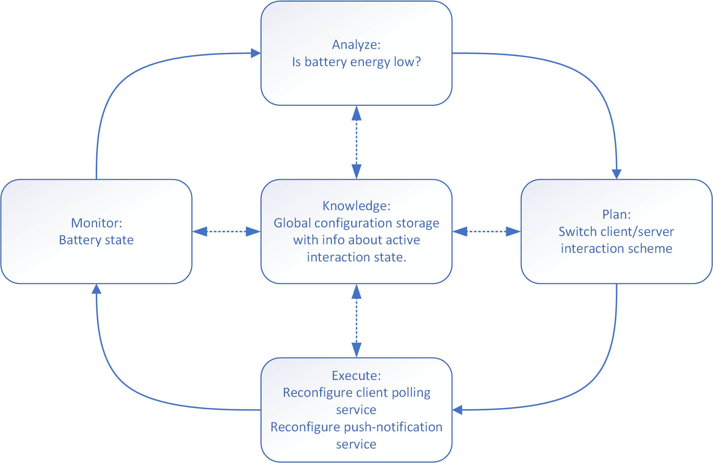
MAPE-K for Energy Challenge

